Slide 1
Emotion Recognition from Text Data Using Classification Algorithms & Voting Classifier (LR-SGD)
122003141 – M Kalyan Venkat - CSE
122015015 – B V N S S Bhargav - IT
122015012 – B Sumanth - IT
SHANMUGHA ARTS, SCIENCE, TECHNOLOGY & RESEARCH ACADEMY
School of Computing
Mini Project
Guide:
Mr. Palanivel, S

Slide 2
Base Paper Details
Base Paper Title: Emotion Recognition by Textual Tweets Classification using Voting Classifier(LR-SGD)
Year of Publication: 2020
Base Paper Link: https://ieeexplore.ieee.org/document/9309291.
DOI: 10.1109/ACCESS.2020.3047831

Slide 3
Abstract
Sentiment analysis is a technique used to analyze the attitude, emotions and opinions of different people towards anything, and it can be carried out on text to analyze public opinion on news, policies, social movements, and personalities. By employing Machine Learning models, opinion mining can be performed without reading tweets manually. Their results could assist governments and businesses in rolling out policies, products, and events. Machine Learning models are implemented for emotion recognition by classifying tweets as happy or unhappy. With an in-depth comparative performance analysis, it was observed that proposed voting classifier(LR-SGD) with TF-IDF produces .the most optimal result .

Slide 4
Introduction
The proliferation of user-generated content on social media has made opinion mining an arduous job.
Recently, social media platforms such as Twitter have generated enormous amounts of structured, unstructured and semi-structured data.
To perform such tasks, accurate NLP techniques and machine learning (ML) models for text classification are required.
Twitter provides an opportunity to its users to analyze its data on a large and broader point of view.
When a person shares experience about a product, it helps the owner to change their market strategy, selling schemes, and improving the quality.

Slide 5
Introduction
Customer reviews serve as a feedback to the owners or manufacturers too.
The data generated in such a way is of large amount and requires an analysis expert team to classify the customer sentiment from the reviews.
Experts can make a human error in sentiment analysis, therefore it requires machine learning and ensemble learning classifiers to accurately classify the sentiment of the customers.
This research presents a voting classifier (LR-SGD) and aims to estimate the performance of famous ML classifiers on twitter datasets.
The ML algorithms include, SVM, Decision Tree Classifier, Naive-Bayes, Random Forest, Gradient-Boosting Machine, Logistic Regression.

Slide 6
Problem Statement
By employing Machine Learning models, opinion mining can be performed without reading text data manually.
The proposed model Voting Classifier(VC) is a cooperative learning which engages multiple individual classifiers and combines their predictions, which could attain better performance than a single classifier.

Slide 7
Literature Survey
Author | Title | Year | Type of Paper | Work
N. F. F. da Silva, E. R. Hruschka, and E. R. Hruschka | Tweet sentiment analysis with classifier ensembles | 2014 | Conference | The authors combine efficiently existing sentiment analysis methods and resources focused the main scopes discussed above. Their goal is to improve two major sentiment analysis tasks: 1) Subjectivity classification, and 2) Polarity classification
C. Kariya and P. Khodke | Twitter sentiment analysis | 2020 | Conference | Efficient methods are important to automatically label text data due to its noisy nature.As Twitter is very fast and an efficient micro-blogging examination that facilitates the end users to transmit small posts are said to be tweets.

Slide 8
Literature Survey
Author | Title | Year | Type of Paper | Work
A. Al saeedi & M. Zubair | A study on sentiment analysis Techniques of Twitter Data | 2019 | Journal | The authors analyzed various kinds of sentiment analysis that is applied on to Twitter dataset and its conclusions. The distinct approaches and conclusions of algorithm performance were compared. Methods used are Naive Bayes, Maximum entropy, svm.
A. Bandhakavi, N. Wiratunga, D. Padmanabhan, and S. Massie | Lexicon based feature extraction for emotion text classification | 2017 | Journal | The authors performed emotion-based feature extraction using domain specific lexicon generation. They captured association of words and emotions using a unigram mixture model. They used tweets that are weakly labelled to classify emotions. Their proposed architecture outperformed other state-of-the art approaches such as Latent Dirichlet Allocation and Pointwise Mutual Information. .

Slide 9
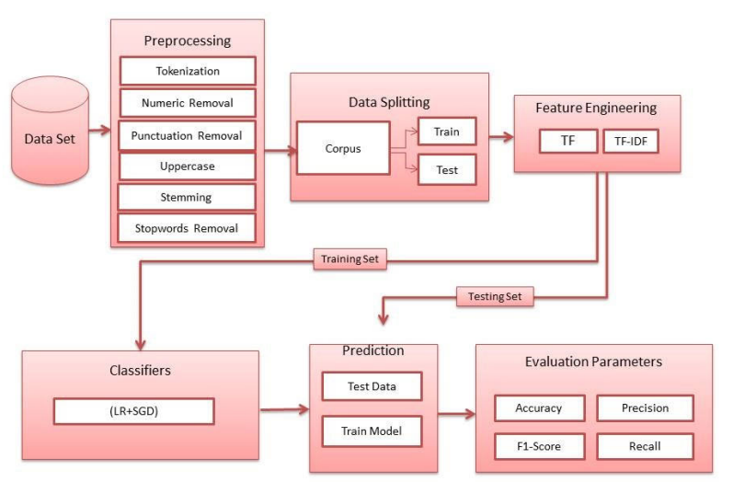
Implementation of methodology

Slide 10
Implementation of methodology
Download the libraries : Pandas, NumPy, matplotlib, seaborn, nltk, sklearn, prettytable.
Perform the Exploratory Data Analysis (EDA).
Tokenization
Numeric Removal
Punctuation Removal
Uppercase
Stemming
Stop words Removal.
Constructed the TF- IDF matrix.
Splitting the Data set into test & train.
Implementing all algorithms ( Random Forest, SVM, Naive Bayes, Gradient Boosting Machine, Logistic Regression, Stochastic Gradient Descent, Voting Classifier.
Visualisation of the results Accuracy, precision, recall & F1-score.

Slide 11
Code
Voting Classifier:
y_pred_7_list=[]
for each_record in x_test:
probi1=lrc.predict_proba(each_record)
probi2=sgd.predict_proba(each_record)
lr_sgd_neg=(probi1[0][0])+(probi2[0][0])/2
lr_sgd_pos=(probi1[0][1])+(probi2[0][1])/2
if(lr_sgd_neg>lr_sgd_pos):
y_pred_7_list.append(0)
else:
y_pred_7_list.append(1)
y_pred_7= np.array(y_pred_7_list)
vc1=accuracy_score(y_pred_7,y_test)
Print(vc1)

Slide 12
Datasets
Data set 1: Twitter sentiment dataset.
https://www.kaggle.com/saurabhshahane/twitter-sentiment-dataset.
Data set 2: Women’s e-commerce clothing dataset.
https://www.kaggle.com/nicapotato/womens-ecommerce-clothing-reviews
Data set 3: Sentiment analysis of hatred speech detection on Twitter.
https://www.kaggle.com/arkhoshghalb/twitter-sentiment-analysis-hatred-speech?select=train.csv
Dataset 4: Emotion-Dataset
https://www.kaggle.com/parulpandey/emotion-dataset

Slide 13
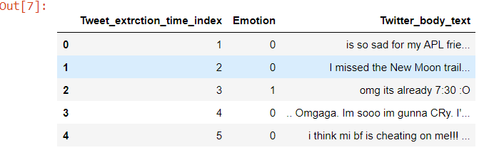
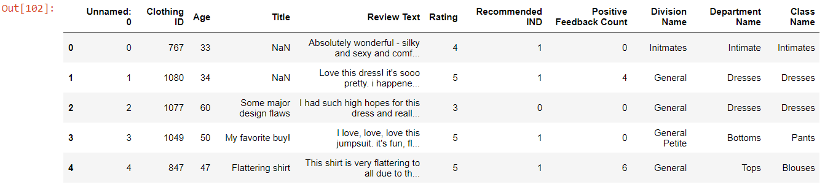
Datasets
The dataset is called ‘‘Sentiment Analysis on Twitter data" and contains 99989 records. Every record is labeled as happy and unhappy according to its sentimental polarity using symbol 1 and 0.
The dataset is called ‘‘Women’s e-commerce clothing reviews" contains 23486 records .

Slide 14
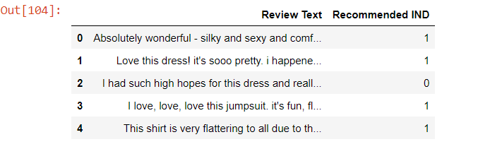
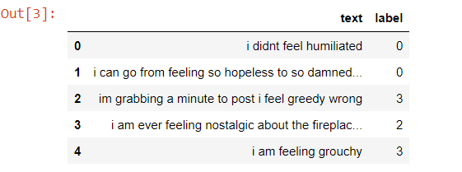
Datasets
Sentiment analysis of hatred speech detection on Twitter- has 29,530 records with 2 classes.
This Dataset has 6 different kinds of emotions such as anger, fear, joy, love, sadness, and surprise.

Slide 15
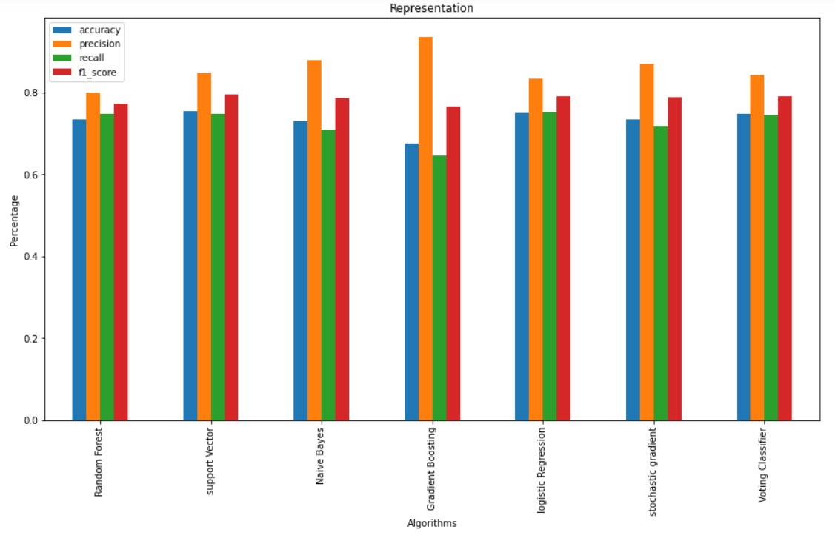
Results
Visualization of results from Twitter sentiment analysis dataset

Slide 16
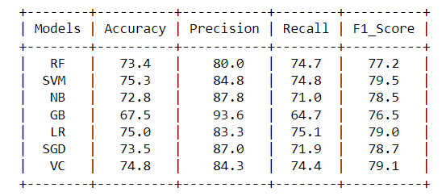
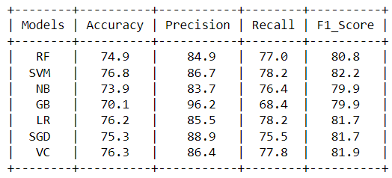
Results
Results of Twitter Sentiment dataset (used in paper)
Stability measure of Women’s e-commerce clothing shopping dataset

Slide 17
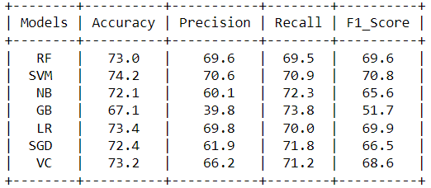
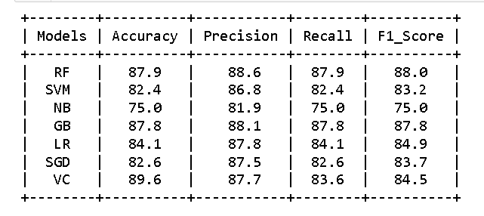
Results
Stability measure of Sentiment analysis on hatred speech detection on Twitter dataset
Results of Emotion Dataset (6 emotions)

Slide 18
Conclusion
This paper proposed a novel combination of LR and SGD as a voting classifier for emotion recognition by classifying tweets as happy or unhappy.
Our experiments showed that one can improve the performance of models by recognizing patterns efficiently and through effective averaging combination of models.
Experiments are conducted to test seven machine learning models that are; (1) SVM, (2) RF, (3) GBM, (4) LR, (5) DT, (6) NB and (7) VC(LR-SGD).
The results showed that all models performed well on tweet dataset but our proposed voting classifier VC(LR-SGD) outperforms by using both TF and TF-IDF among all.
Proposed model achieves the highest results using TF-IDF with 79% Accuracy, 84% Recall and 81% F1-score.

Slide 19
Future Work
The future work will compare more feature engineering techniques and explore more combinations of ensemble models to improve the performance.
In addition, emotions can be predicted from photos and videos through facial recognition.

Slide 20
References
N. F. F. da Silva, E. R. Hruschka, and E. R. Hruschka, ‘‘Tweet sentiment analysis with classifier ensembles,’’ Decis. Support Syst., vol. 66, pp. 170–179.
H. Hakh, I. Aljarah, and B. Al-Shboul, ‘‘Online social media-based sentiment analysis for us airline companies,’’ in New Trends in Information Technology. Amman, Jordan: Univ. of Jordan.
S. Sadiq, A. Mehmood, S. Ullah, M. Ahmad, G. S. Choi, and B.-W. On, ‘‘Aggression detection through deep neural model on Twitter,’’ Future Gener. Comput. Syst., vol. 114, pp. 120–129, Jan. 2021.
D. Gamal, M. Alfonse, E.-S. M. El-Horbaty, and A.-B. M. Salem, ‘‘Twitter benchmark dataset for arabic sentiment analysis,’’ Int. J. Modern Edu. Comput. Sci., vol. 11, no. 1, pp. 33–38, Jan. 2019.

Slide 21


